Slide 1


Food quality prediction using Machine learning
BY:
ANUSHKA ARORA
UNDER MENTORSHIP OF:
MR KIREET JOSHI

Slide 2
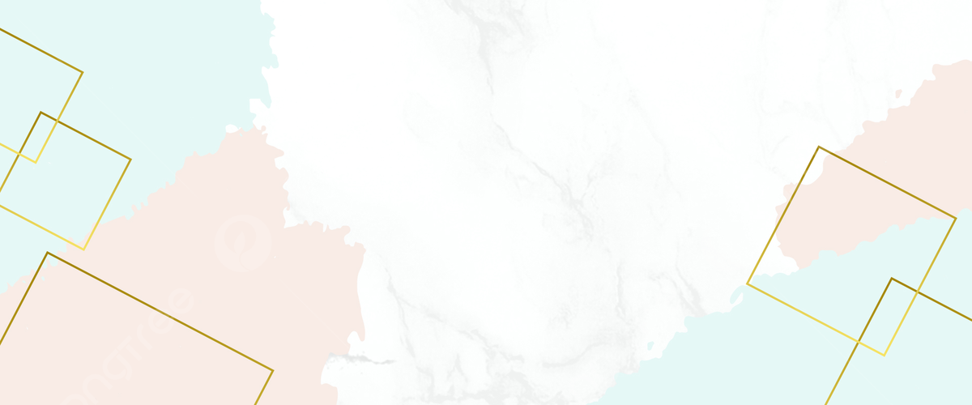
OUTLINE
INTRODUCTION
PROBLEM STATEMENT
METHODOLOGY
RESULT AND DISCUSSION
CONCLUSION
FUTURE WORK

Slide 3

INTRODUCTION
In the cooking and food industry, it's tricky to always make really good food. People want food to taste great every time they eat it. To do this, we need to find new ways beyond the usual ways of cooking. This is where machine learning comes in. It's like using smart technology to predict and make sure the food turns out amazing every time.

Slide 4

PROBLEM STATEMENT
Cooking has a big challenge. People's tastes change, and there are many things that affect how good the food is. Chefs and food makers have a tough job of not just making good food but making it even better each time. The usual ways of cooking and making recipes sometimes don't work well with the complex tastes people have nowadays. So, we need a new way to make sure the food is always fantastic.

Slide 5
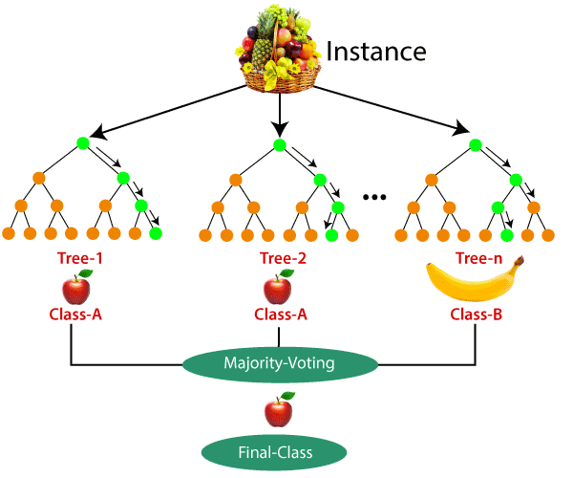
METHODOLOGY
Our methodology revolves around utilizing a RandomForest Regressor, a robust machine learning algorithm, to predict food quality based on a set of carefully chosen features
The workflow involves :
1)data preprocessing
2)model training
3) evaluation
4)application to predict food quality
for new input parameters.

Slide 6

METHODOLOGY
Data Collection and Preprocessing:
1. Data Collection:
Collect a diverse dataset with information like ingredients, cooking time, spices, ambiance score, presentation score, spiciness level, and overall satisfaction.
Ensure data is reliable, fixing any missing or inconsistent values.
2. Feature Engineering:
Create new features if necessary, like a total taste score.
Adjust numerical features to make sure they're on the same scale.
3. Data Splitting:
Divide the dataset into training (80%) and testing (20%) using the train_test_split function.

Slide 7

METHODOLOGY
Model Selection and Training:
1. RandomForest Regressor:
Choose this model for its ability to handle complex relationships and provide insights into feature importance.
Start with 100 decision trees for a strong ensemble learning.
2. Model Training:
Train the RandomForest Regressor on the training data using the fit() function.
Model Evaluation:
1.Predictions on Test Set:
Use the trained model to predict food quality
on the test set (X_test).
Get predicted food quality values (y_pred).
2. Evaluation Metrics:
Calculate Mean Squared Error (MSE) and
R-squared (R2) scores to see how well the
model predicts.
Analyze these metrics to understand the model's
accuracy in capturing food quality variance.

Slide 8
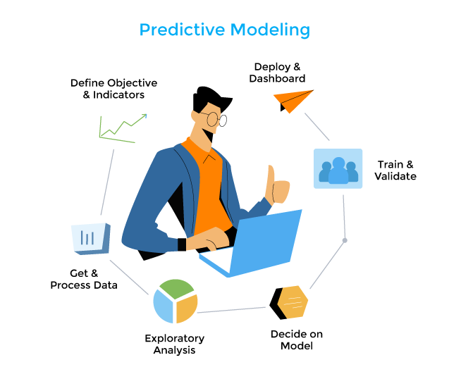
METHODOLOGY
Model Application and Prediction:
1.New Input Parameters:
Gather new parameters for a food item (ingredients, cooking time, etc.).
Organize them into a DataFrame (X_new).
2. Prediction:
Use the trained model to predict food quality for the new input parameters.
Get the predicted food quality value for the given inputs.
Visualization:
1. Bar Graph:
Create a bar graph to compare actual vs.
predicted food quality on the test set.
Show real food quality alongside the
model's predictions for each sample.
Model Interpretability:
1. Feature Importance:
Extract importance scores from the model.
Visualize how each feature contributes to
the overall food quality prediction.

Slide 9
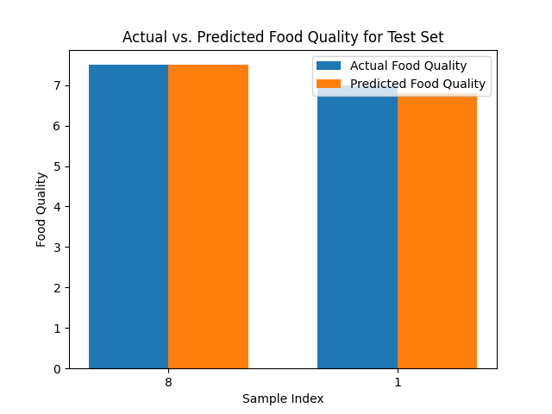
RESULT AND DISCUSSION
Evaluation Metrics:
Mean Squared Error (MSE):
Calculated MSE on the test set: 0.00965
A lower MSE indicates better predictive performance.
R-squared (R2) Score:
Computed R2 score on the test set: 0.84559
R2 close to 1 signifies a good fit of the model
to the data.
Bar Graph - Actual vs. Predicted Food Quality:
The bar graph visually represents the food
quality predictions on the test set.
Each bar corresponds to a sample index,
showing the actual food quality alongside
the model's predictions.

Slide 10
RESULT AND DISCUSSION
The bar graph visually represents the food quality predictions on the test set.
Each bar corresponds to a sample index, showing the actual food quality alongside the model's predictions.
-Discrepancies between actual and predicted values are noticeable, indicating areas for model improvement.
Feature Importance Scores:
Features such as Ingredients and Cooking Time have the highest importance scores, indicating their significant influence on food quality predictions.
Ambiance Score and Presentation Score also contribute meaningfully to the model's predictions.
FEATURES | SCORES
Ingredients | [7]
CookingTime | [40]
Spices | [3]
preparationTime | [25]
AmbianceScore | [8]
PresentationScore | [9]
SpicinessLevel | [2]

Slide 11
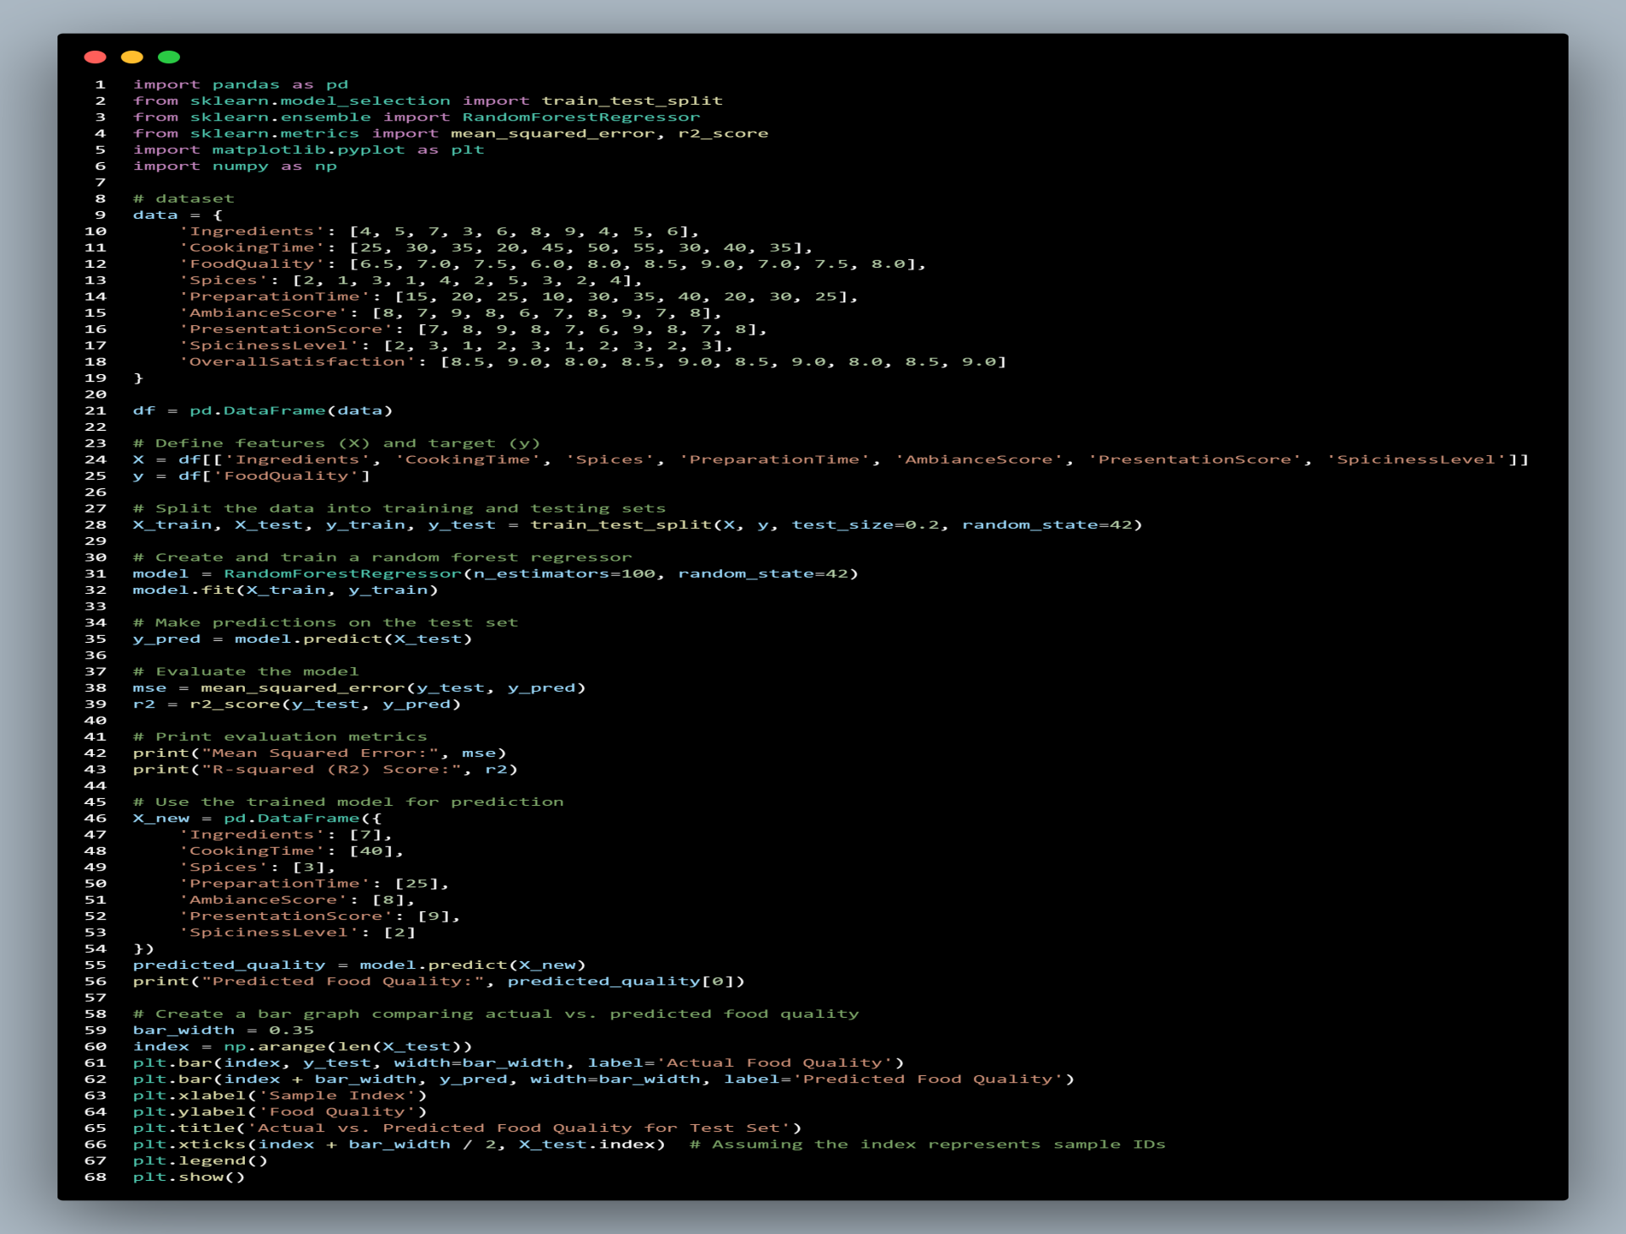
CODE

Slide 12
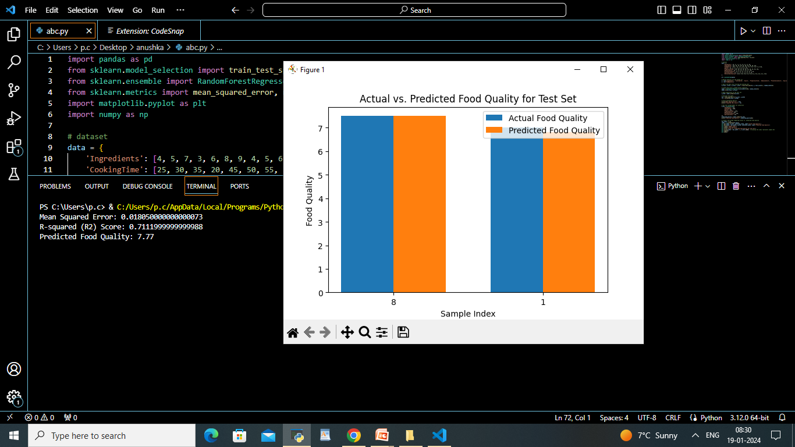
OUTPUT

Slide 13

RESULT AND DISCUSSION
Predicted Food Quality:
The model predicts the food quality for the provided input parameters: 7.77
Discussion on the practical implications of the predicted food quality in real world culinary scenarios.
Discussion:
>> Interpretation of the bar graph reveals areas where the model excels and potential areas for refinement.
>> Feature importance scores offer insights
into the key drivers of food quality predictions.
>>The model's predictive capability is
discussed in the context of its
application to diverse culinary scenarios.

Slide 14

CONCLUSION
Conclusion:
Our exploration into predicting food quality using the RandomForest Regressor has given us valuable insights for the culinary arts. The model, trained on diverse data like ingredients and cooking time, showed promising predictions.
Key Findings:
The model is pretty accurate, with low error and a high score on the test set.
Ingredients, cooking time, and ambiance score play a big role in predicting food quality.
A bar graph visually showed how well the model predicted food quality compared to the actual values.
Practical Implications:
Chefs and food producers can use this model to improve recipes and cooking processes.
Knowing which features matter most helps chefs focus on what makes a dish taste great.

Slide 15

FUTURE WORK
Future Work:
Model Refinement:
We plan to make the model better by using more diverse datasets with different cuisines.
Adjusting settings and trying more advanced techniques can improve accuracy.
Real-Time Data:
Adding data from sensors and customer feedback can make the model adapt to changing preferences.
Personalized Recommendations:
Expanding the model to give personalized recipe suggestions based on individual tastes is an exciting next step.
Listening to user feedback helps us make the model better over time.

Slide 16
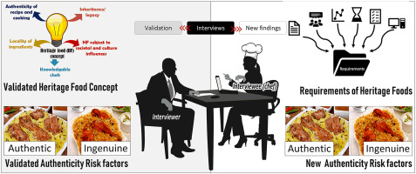
FUTURE WORK
Collaboration with Culinary Experts:
Working with chefs and food experts can give us qualitative insights that go beyond just numbers.
Exploring Advanced Algorithms:
Trying out advanced machine learning methods, like deep learning, might uncover new patterns in the data.
Vision:
Our goal is to blend data science with
culinary arts, making predictive modeling
creative part of cooking. As we refine our
models, we want to give chefs and food
enthusiasts tools that not only improve
dishes but also spark innovation in the
culinary world.

Slide 17


